Slide 1
ITERATIVE STATEMENTS

Slide 2
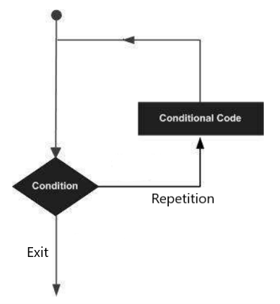
ITERATIVE STATEMENTS
An iteration statement allows us to execute a statement or group of statements multiple times/repetitively.
These are also called Looping Statements.
The set of statements that are repeated again and again is called the body of the loop.

Slide 3
ITERATIVE STATEMENTS
There are two types of looping statements in Python:
Conditional loops – while loop
Counter loops – for loop
EXAMPLE
Our daily routine
The actions we repeat daily like waking up, brushing teeth, bathing, etc. are repetitive in nature. These form a loop.

Slide 4
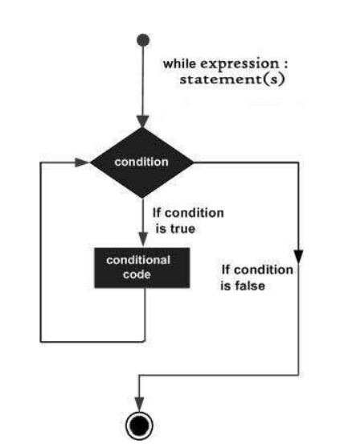
while LOOP
While loop repeats its body (the set of statements under it) depending upon a test condition.
The condition on which the execution or exit of the loop depends is called the exit condition or test condition.

Slide 5
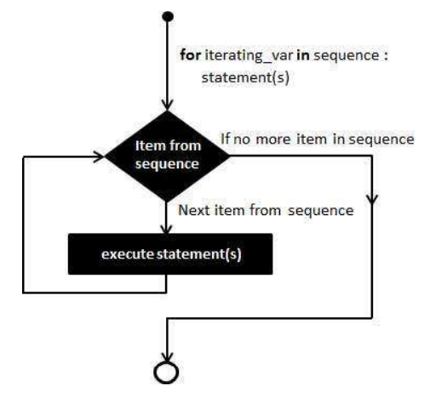
for LOOP
While loop repeats its body (the set of statements under it) depending upon a test condition.
The condition on which the execution or exit of the loop depends is called the exit condition or test condition.

Slide 6
Happy Learning!

